Slide 1
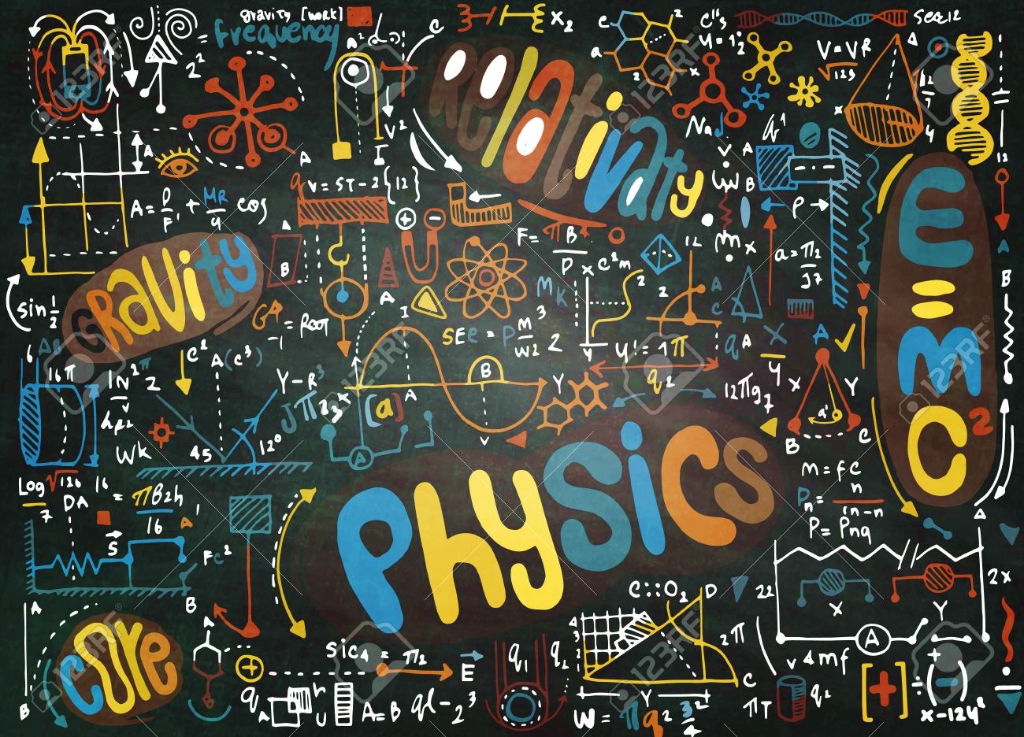
The Universe Around Us Unit 1: Foundations of Physics and Astronomy

Slide 2
1. Introduction to Science
a.k.a. what is and how it works

Slide 3
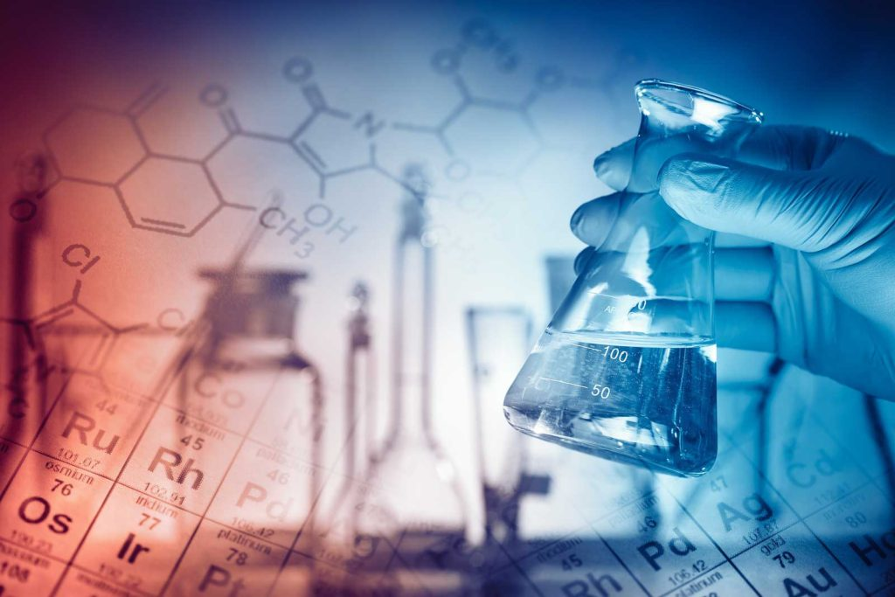
What is science?

Slide 4
2. Newton’s Revolution
a.k.a. the history of modern science

Slide 5
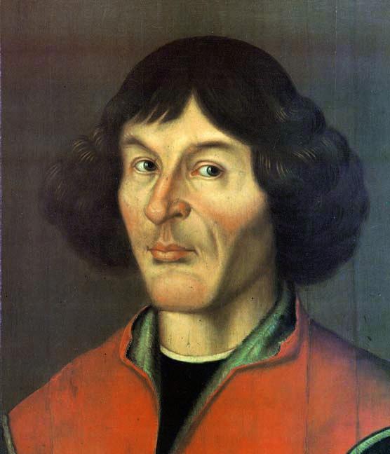
(1473-1543)
1500 1600 1700 1800 1900 2000
Copernicus
(Dr.) Nicolaus Copernicus
Lawyer, doctor, mathematician, astronomer

Slide 6
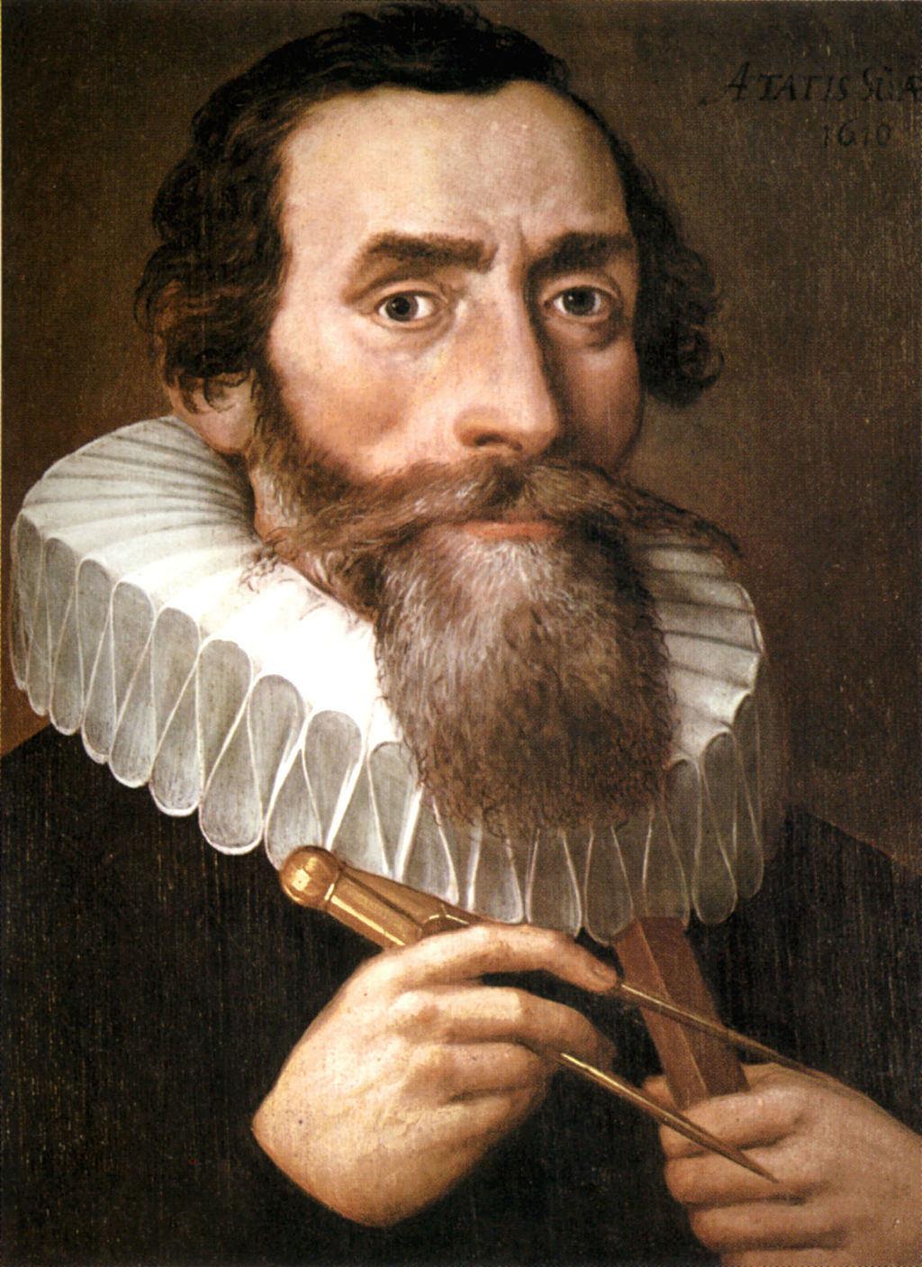
(1571-1630)
1500 1600 1700 1800 1900 2000
Copernicus
Galilei (1564-1642)
Brahe (1546-1601)
Kepler
Johannes Kepler
Astronomer, mathematician, astrologer

Slide 7
(1571-1630)
1500 1600 1700 1800 1900 2000
Copernicus
Galilei (1564-1642)
Brahe (1546-1601)
Kepler
Johannes Kepler
Astronomer, mathematician, astrologer
Kepler’s laws:
Planets revolve in ellipses (1609).
Equal areas in equal times (1609).
P² proportional to a³ (1619)

Slide 8
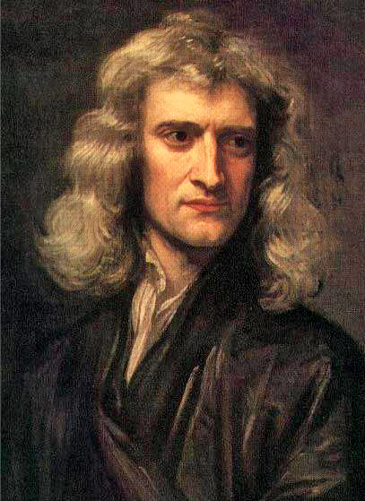
(1642-1726)
1500 1600 1700 1800 1900 2000
Copernicus
Galilei (1564-1642)
Brahe (1546-1601)
Kepler
Newton
Isaac Newton
Astronomer, mathematician, physicist

Slide 9
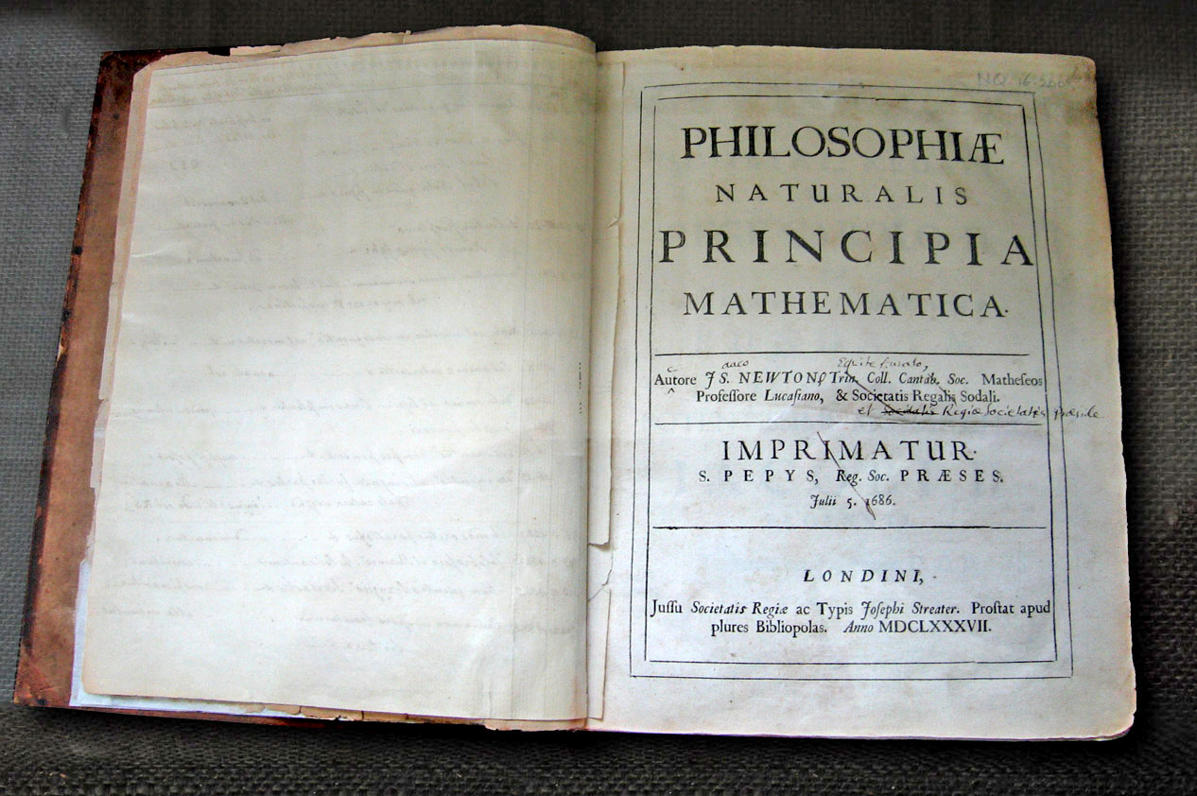
(1642-1726)
1500 1600 1700 1800 1900 2000
Copernicus
Galilei (1564-1642)
Brahe (1546-1601)
Kepler
Newton
Isaac Newton
Astronomer, mathematician, physicist

Slide 10
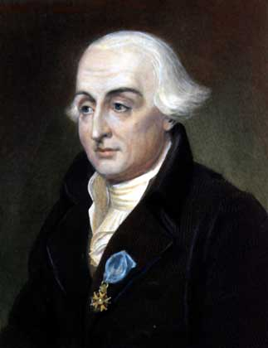
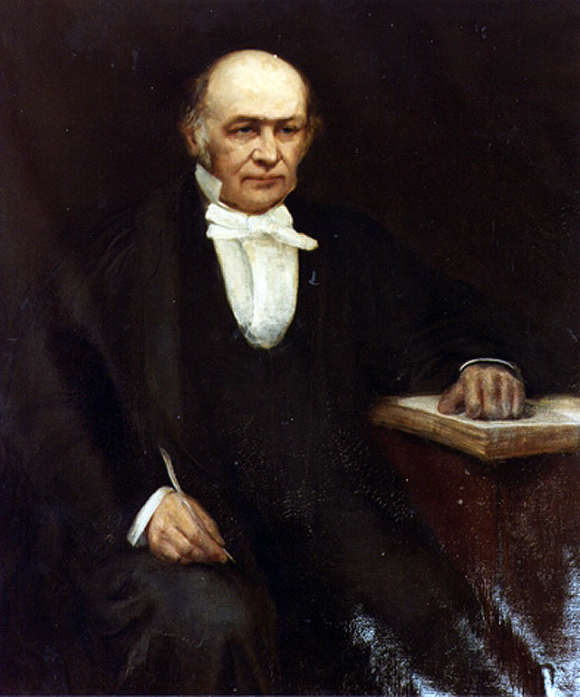
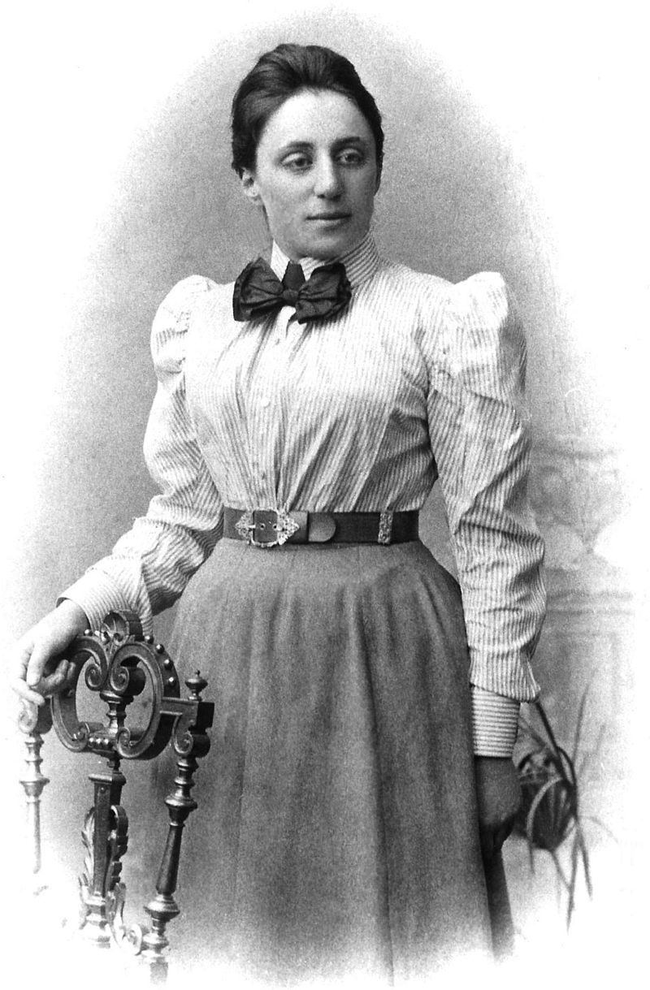
1500 1600 1700 1800 1900 2000
Copernicus
Galilei (1564-1642)
Lagrange (1736-1813)
Noether (1882-1935)
Brahe (1546-1601)
Kepler
Newton
Hamilton (1805-1865)
J.L. Lagrange
W.R. Hamilton
E. Noether

Slide 11
3. The Nature of Light

Slide 12
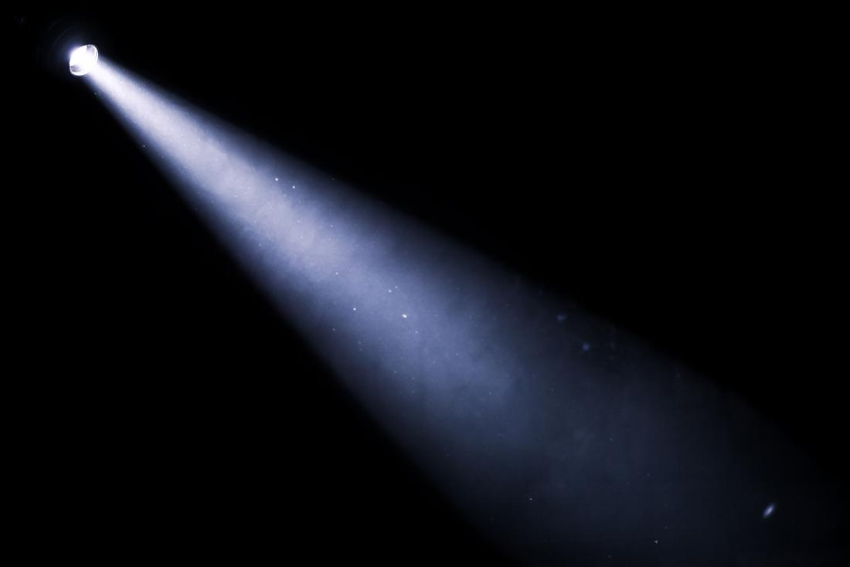
What is light?

Slide 13
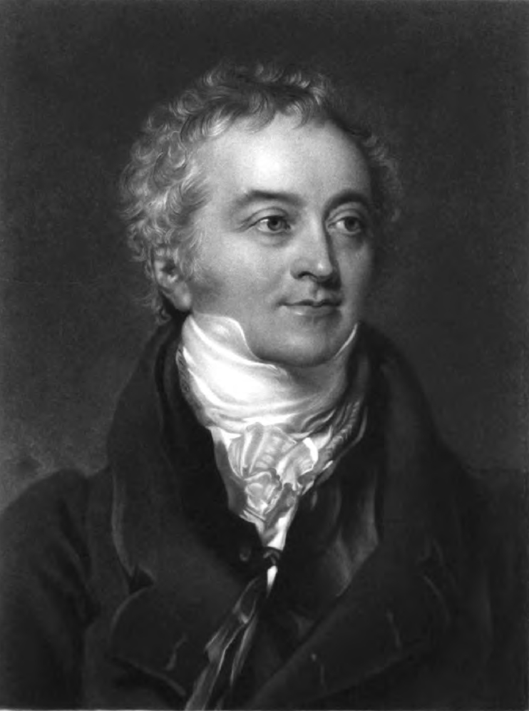
(1773-1829)
1500 1600 1700 1800 1900 2000
Copernicus
Galilei (1564-1642)
Lagrange (1736-1813)
Young
Noether (1882-1935)
Brahe (1546-1601)
Kepler
Newton
Hamilton (1805-1865)
Thomas Young
Polymath, physician

Slide 14
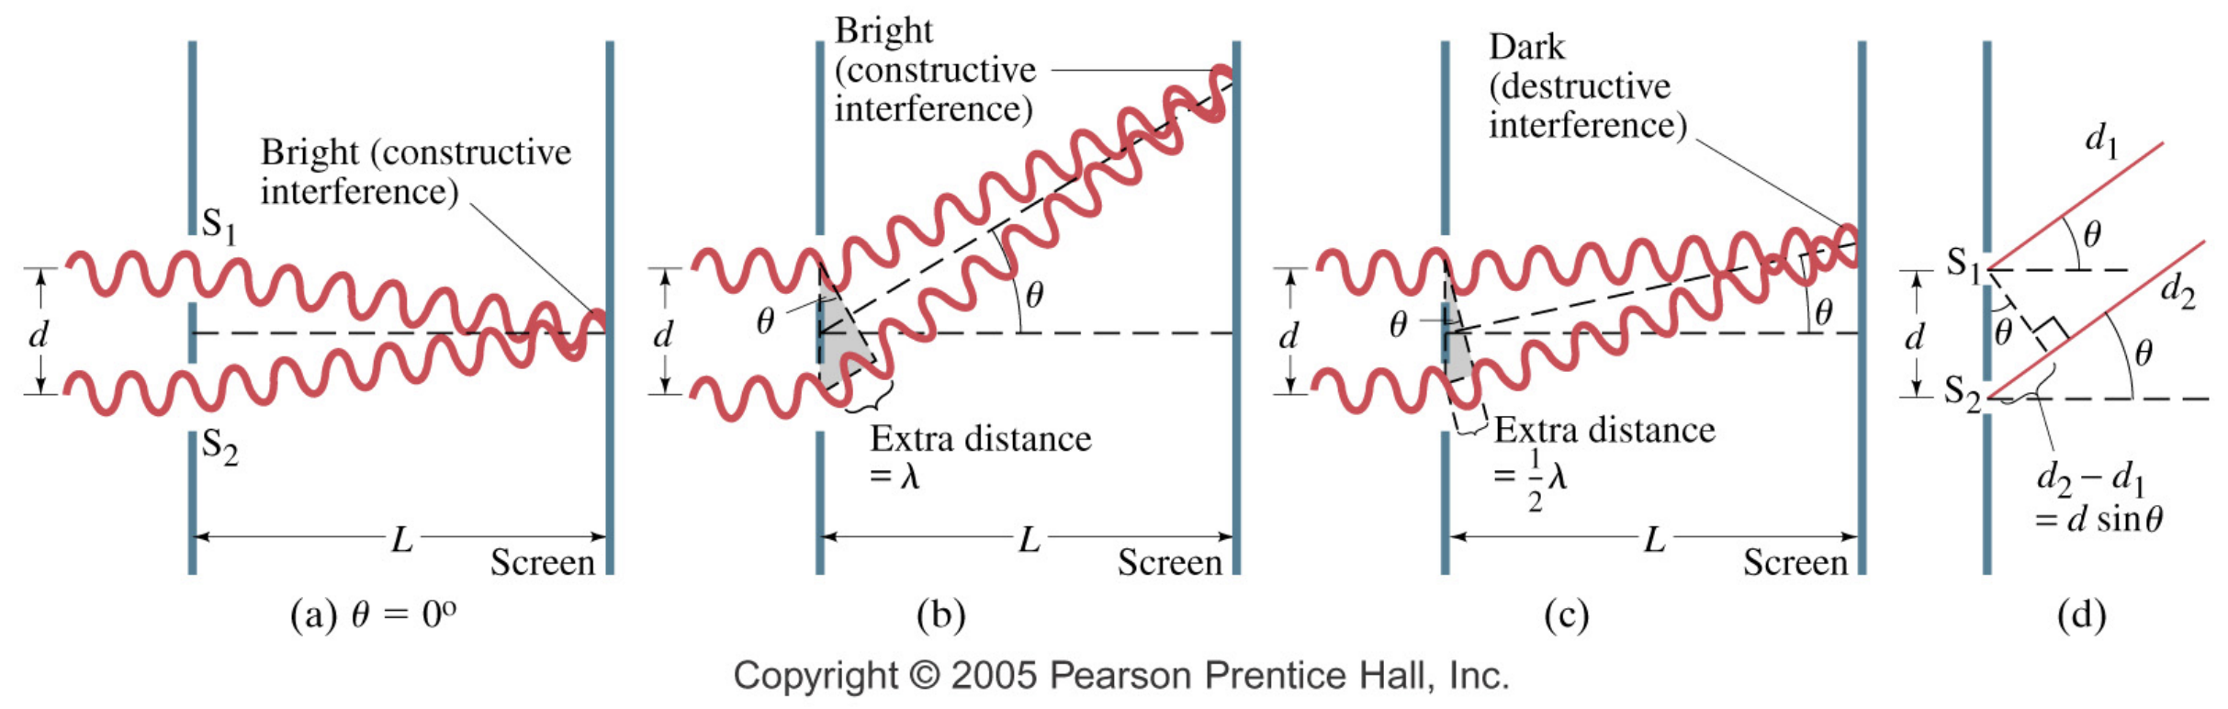
(1773-1829)
1500 1600 1700 1800 1900 2000
Copernicus
Galilei (1564-1642)
Lagrange (1736-1813)
Young
Noether (1882-1935)
Brahe (1546-1601)
Kepler
Newton
Hamilton (1805-1865)
Thomas Young
Polymath, physician

Slide 15
What is light?

Slide 16
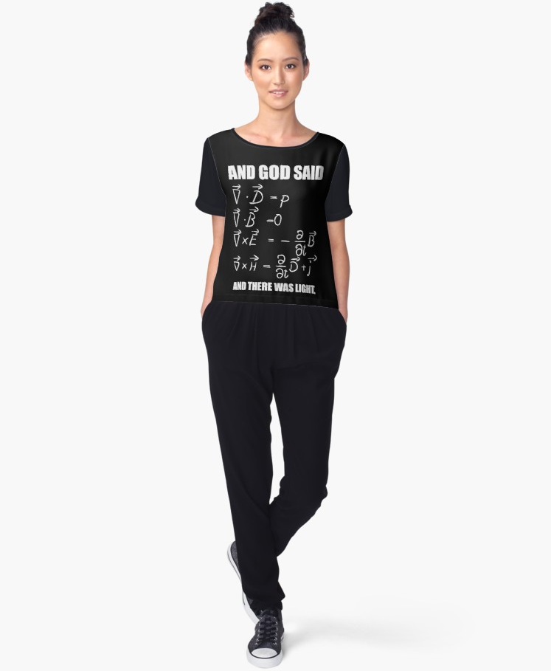
1500 1600 1700 1800 1900 2000
Copernicus
Galilei (1564-1642)
Lagrange (1736-1813)
Young
Maxwell
Noether (1882-1935)
Brahe (1546-1601)
Kepler
Newton
Hamilton (1805-1865)
(1831-1879)
James C. Maxwell
(“his” equations)

Slide 17
1500 1600 1700 1800 1900 2000
Copernicus
Galilei (1564-1642)
Lagrange (1736-1813)
Young
Maxwell
Noether (1882-1935)
Brahe (1546-1601)
Kepler
Newton
Hamilton (1805-1865)
(1831-1879)
James C. Maxwell
(“his” equations)
Speed of light (c):
c = 299,792 km/s
~ 300,000 km/s

Slide 18
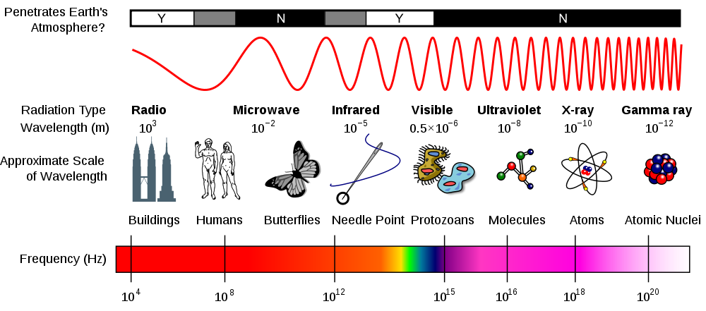
The Electromagnetic Spectrum!
1500 1600 1700 1800 1900 2000
Copernicus
Galilei (1564-1642)
Lagrange (1736-1813)
Young
Maxwell
Noether (1882-1935)
Brahe (1546-1601)
Kepler
Newton
Hamilton (1805-1865)

Slide 19
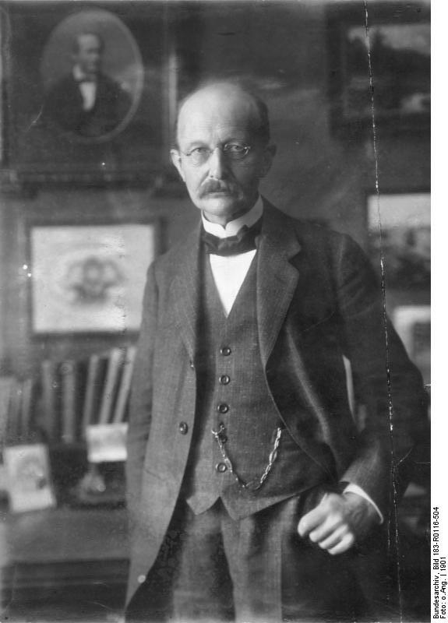
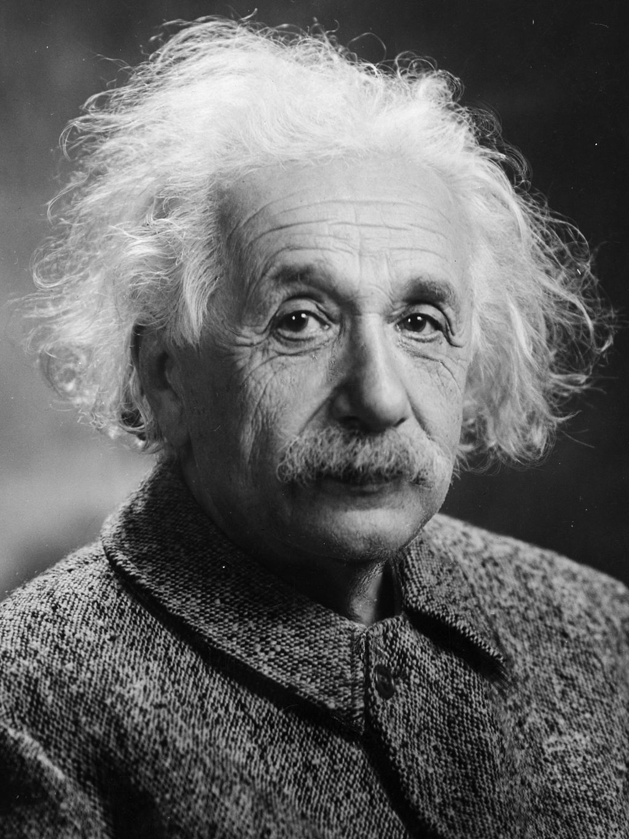
1500 1600 1700 1800 1900 2000
Copernicus
Galilei (1564-1642)
Lagrange (1736-1813)
Young
Maxwell
Noether (1882-1935)
Einstein
Brahe (1546-1601)
Kepler
Newton
Hamilton (1805-1865)
Planck
(1879-1955)
(1858-1947)
Max-Planck
Albert Einstein

Slide 20
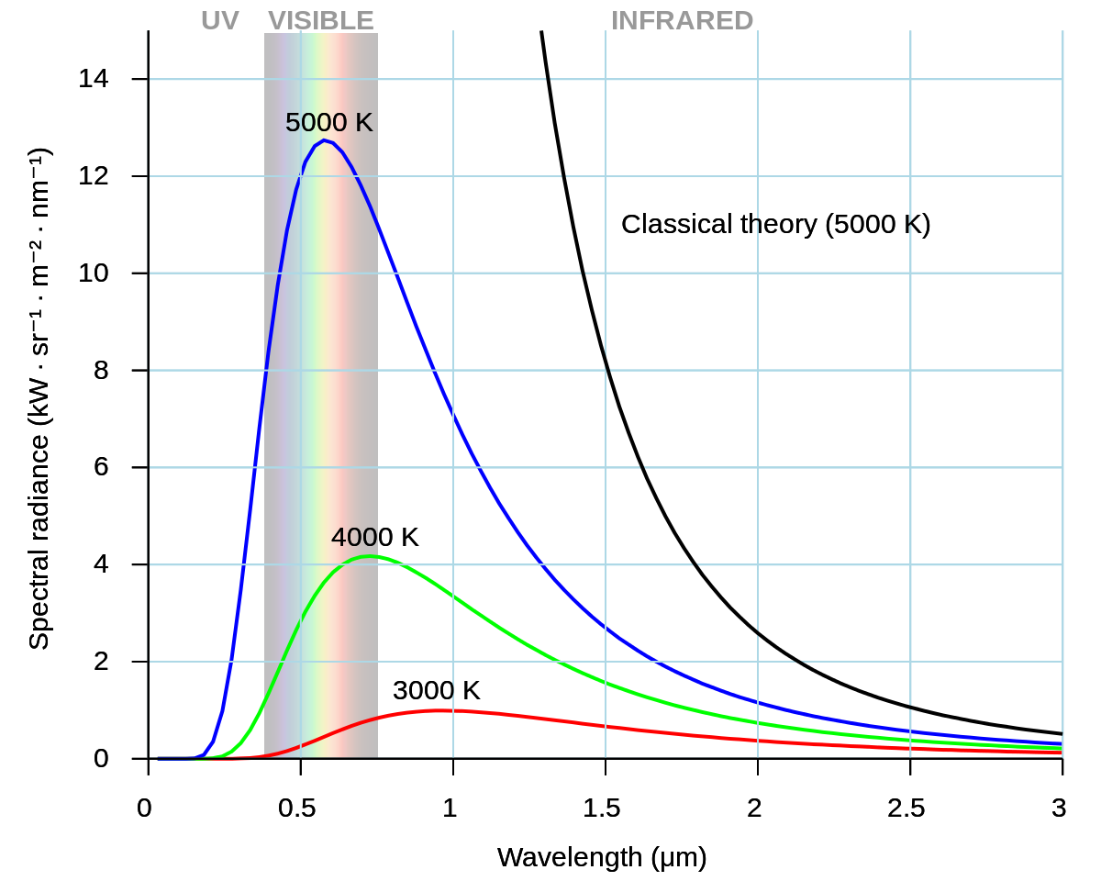
1500 1600 1700 1800 1900 2000
Copernicus
Galilei (1564-1642)
Lagrange (1736-1813)
Young
Maxwell
Noether (1882-1935)
Einstein
Brahe (1546-1601)
Kepler
Newton
Hamilton (1805-1865)
Planck

Slide 21
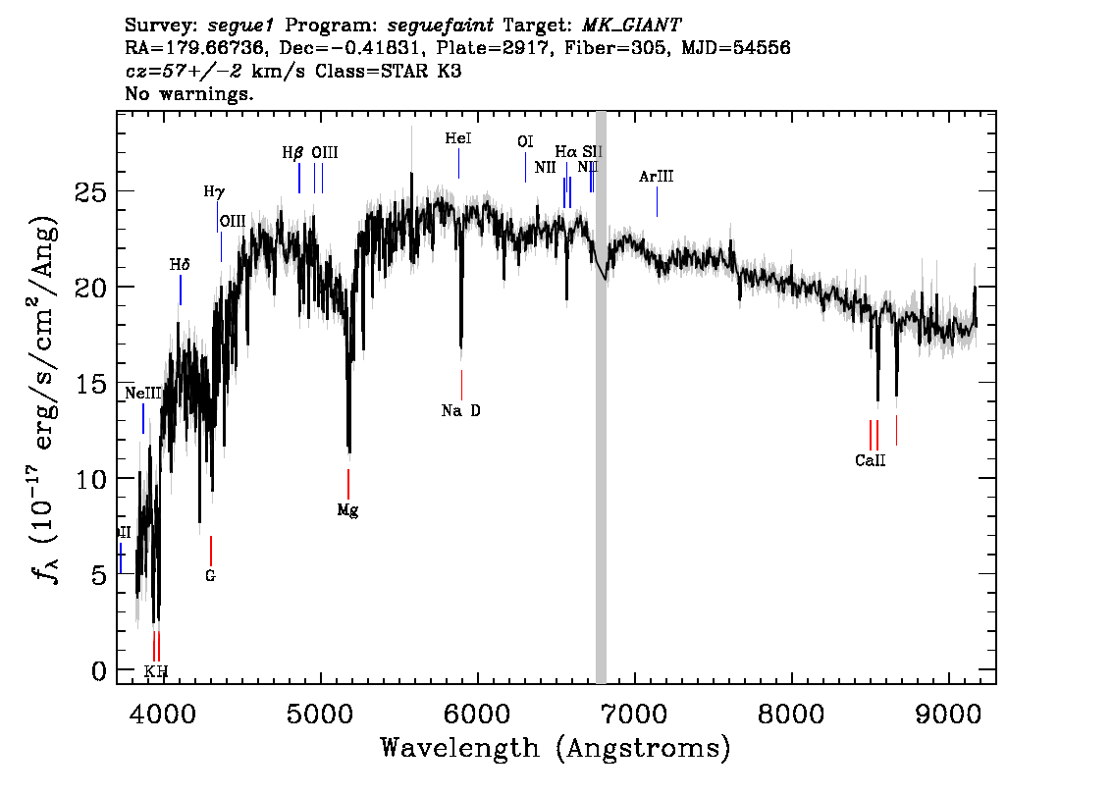
1500 1600 1700 1800 1900 2000
Copernicus
Galilei (1564-1642)
Lagrange (1736-1813)
Young
Maxwell
Noether (1882-1935)
Einstein
Brahe (1546-1601)
Kepler
Newton
Hamilton (1805-1865)
Planck
A

Slide 22
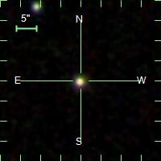
1500 1600 1700 1800 1900 2000
Copernicus
Galilei (1564-1642)
Lagrange (1736-1813)
Young
Maxwell
Noether (1882-1935)
Einstein
Brahe (1546-1601)
Kepler
Newton
Hamilton (1805-1865)
Planck
1
A

Slide 23
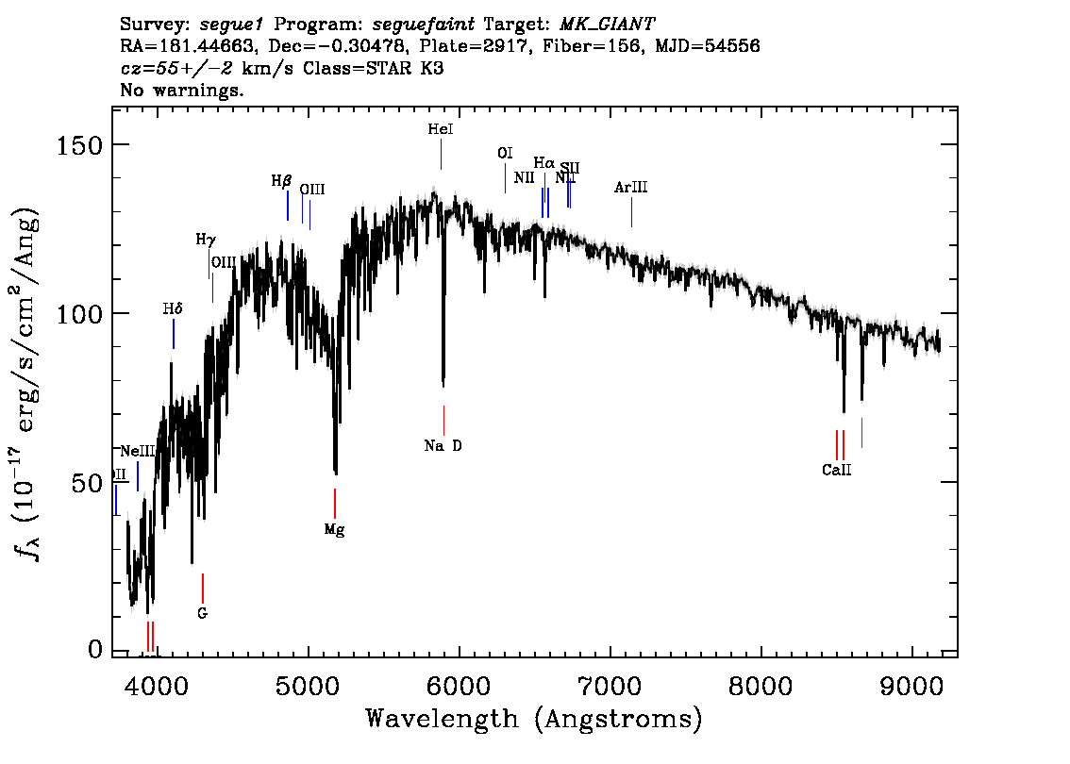
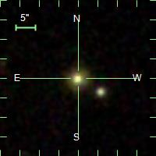
1500 1600 1700 1800 1900 2000
Copernicus
Galilei (1564-1642)
Lagrange (1736-1813)
Young
Maxwell
Noether (1882-1935)
Einstein
Brahe (1546-1601)
Kepler
Newton
Hamilton (1805-1865)
Planck
B

Slide 24
1500 1600 1700 1800 1900 2000
Copernicus
Galilei (1564-1642)
Lagrange (1736-1813)
Young
Maxwell
Noether (1882-1935)
Einstein
Brahe (1546-1601)
Kepler
Newton
Hamilton (1805-1865)
Planck
4
B

Slide 25
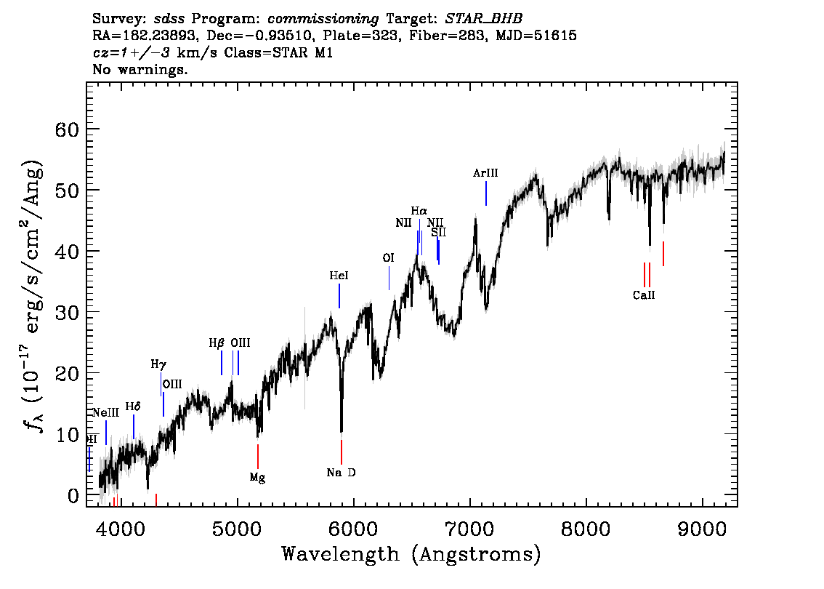
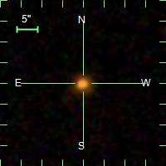
1500 1600 1700 1800 1900 2000
Copernicus
Galilei (1564-1642)
Lagrange (1736-1813)
Young
Maxwell
Noether (1882-1935)
Einstein
Brahe (1546-1601)
Kepler
Newton
Hamilton (1805-1865)
Planck
C

Slide 26
1500 1600 1700 1800 1900 2000
Copernicus
Galilei (1564-1642)
Lagrange (1736-1813)
Young
Maxwell
Noether (1882-1935)
Einstein
Brahe (1546-1601)
Kepler
Newton
Hamilton (1805-1865)
Planck
2
C

Slide 27
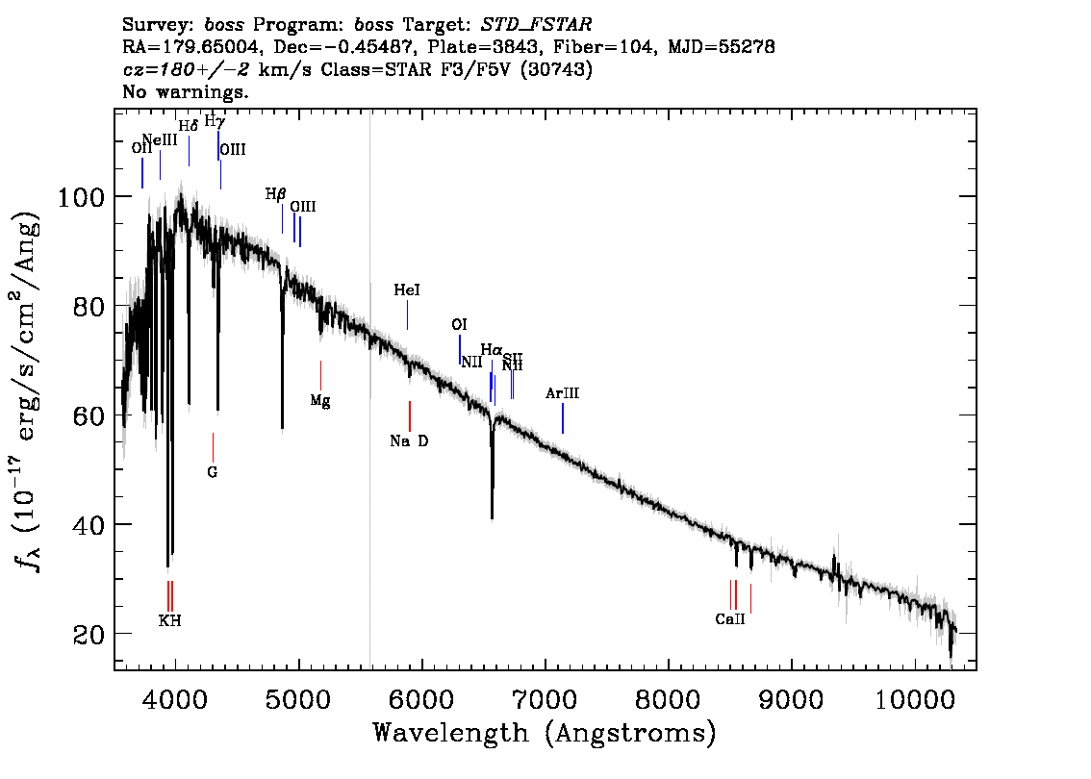
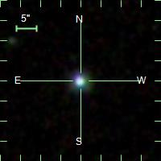
1500 1600 1700 1800 1900 2000
Copernicus
Galilei (1564-1642)
Lagrange (1736-1813)
Young
Maxwell
Noether (1882-1935)
Einstein
Brahe (1546-1601)
Kepler
Newton
Hamilton (1805-1865)
Planck
D

Slide 28
1500 1600 1700 1800 1900 2000
Copernicus
Galilei (1564-1642)
Lagrange (1736-1813)
Young
Maxwell
Noether (1882-1935)
Einstein
Brahe (1546-1601)
Kepler
Newton
Hamilton (1805-1865)
Planck
3
D

Slide 29
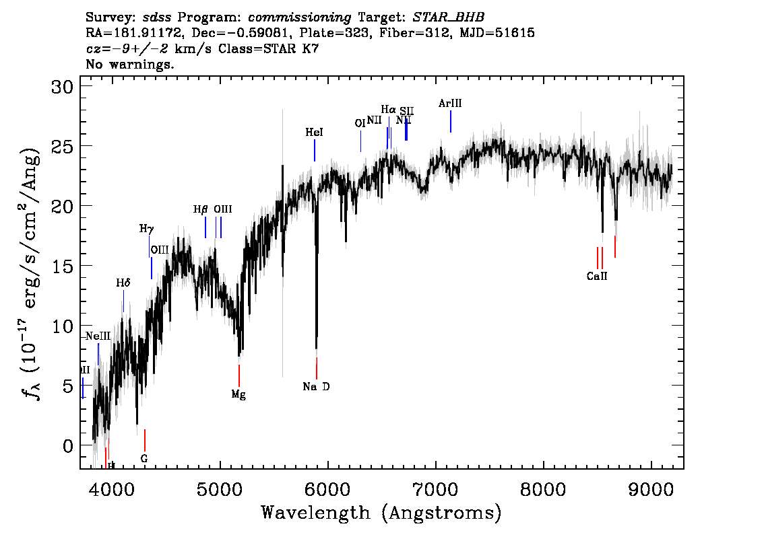
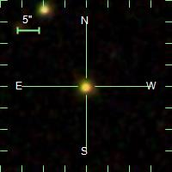
1500 1600 1700 1800 1900 2000
Copernicus
Galilei (1564-1642)
Lagrange (1736-1813)
Young
Maxwell
Noether (1882-1935)
Einstein
Brahe (1546-1601)
Kepler
Newton
Hamilton (1805-1865)
Planck
E

Slide 30
1500 1600 1700 1800 1900 2000
Copernicus
Galilei (1564-1642)
Lagrange (1736-1813)
Young
Maxwell
Noether (1882-1935)
Einstein
Brahe (1546-1601)
Kepler
Newton
Hamilton (1805-1865)
Planck
6
E

Slide 31
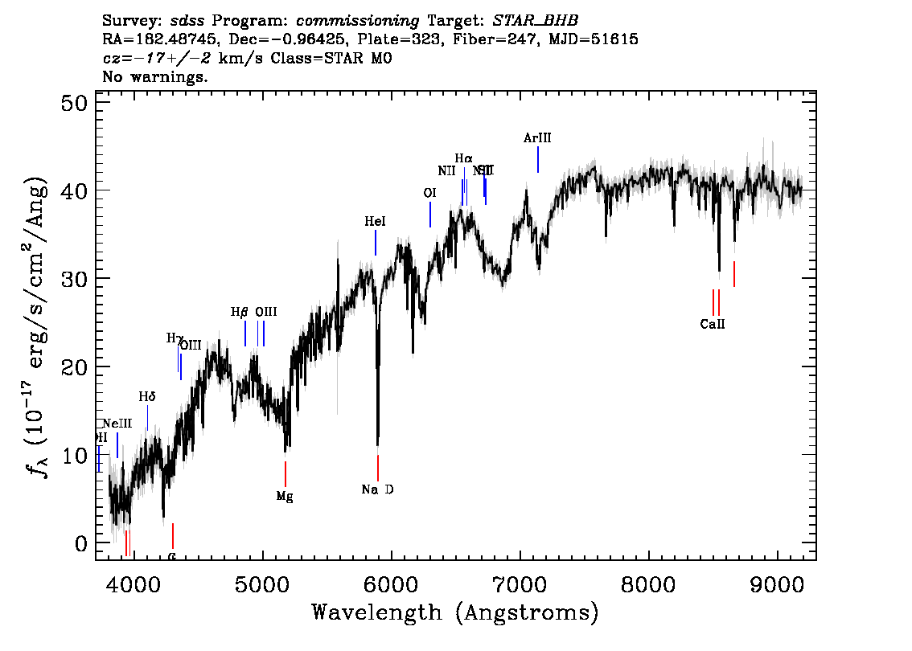
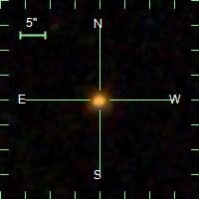
1500 1600 1700 1800 1900 2000
Copernicus
Galilei (1564-1642)
Lagrange (1736-1813)
Young
Maxwell
Noether (1882-1935)
Einstein
Brahe (1546-1601)
Kepler
Newton
Hamilton (1805-1865)
Planck
F

Slide 32
1500 1600 1700 1800 1900 2000
Copernicus
Galilei (1564-1642)
Lagrange (1736-1813)
Young
Maxwell
Noether (1882-1935)
Einstein
Brahe (1546-1601)
Kepler
Newton
Hamilton (1805-1865)
Planck
5
F

Slide 33
Instructions for use
EDIT IN GOOGLE SLIDES
Click on the button under the presentation preview that says "Use as Google Slides Theme".
You will get a copy of this document on your Google Drive and will be able to edit, add or delete slides.
You have to be signed in to your Google account.
EDIT IN POWERPOINT®
Click on the button under the presentation preview that says "Download as PowerPoint template". You will get a .pptx file that you can edit in PowerPoint.
Remember to download and install the fonts used in this presentation (you’ll find the links to the font files needed in the Presentation design slide)
More info on how to use this template at www.slidescarnival.com/help-use-presentation-template
This template is free to use under Creative Commons Attribution license. You can keep the Credits slide or mention SlidesCarnival and other resources used in a slide footer.

Slide 34
Quotations are commonly printed as a means of inspiration and to invoke philosophical thoughts from the reader.

Slide 35
This is a slide title
Here you have a list of items
And some text
But remember not to overload your slides with content
Your audience will listen to you or read the content, but won’t do both.

Slide 36
Big concept
Bring the attention of your audience over a key concept using icons or illustrations

Slide 37
You can also split your content
White
Is the color of milk and fresh snow, the color produced by the combination of all the colors of the visible spectrum.
Black
Is the color of coal, ebony, and of outer space. It is the darkest color, the result of the absence of or complete absorption of light.

Slide 38
In two or three columns
Yellow
Is the color of gold, butter and ripe lemons. In the spectrum of visible light, yellow is found between green and orange.
Blue
Is the colour of the clear sky and the deep sea. It is located between violet and green on the optical spectrum.
Red
Is the color of blood, and because of this it has historically been associated with sacrifice, danger and courage.

Slide 39
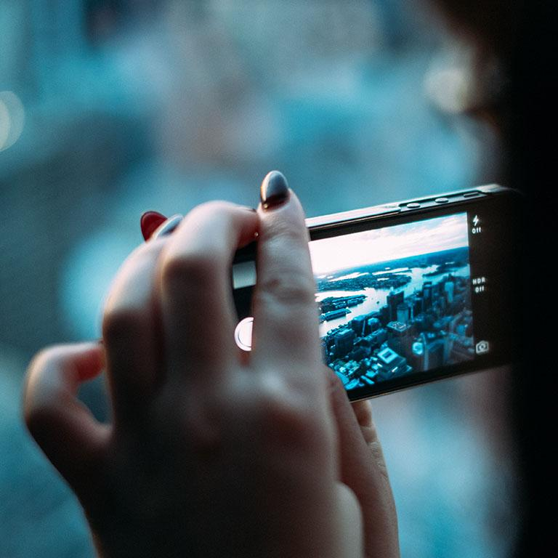
A picture is worth a thousand words
A complex idea can be conveyed with just a single still image, namely making it possible to absorb large amounts of data quickly.

Slide 40
Want big impact?
Use big image.

Slide 41
Use charts to explain your ideas
Gray
White
Black

Slide 42
And tables to compare data
 | A | B | C
Yellow | 10 | 20 | 7
Blue | 30 | 15 | 10
Orange | 5 | 24 | 16

Slide 43
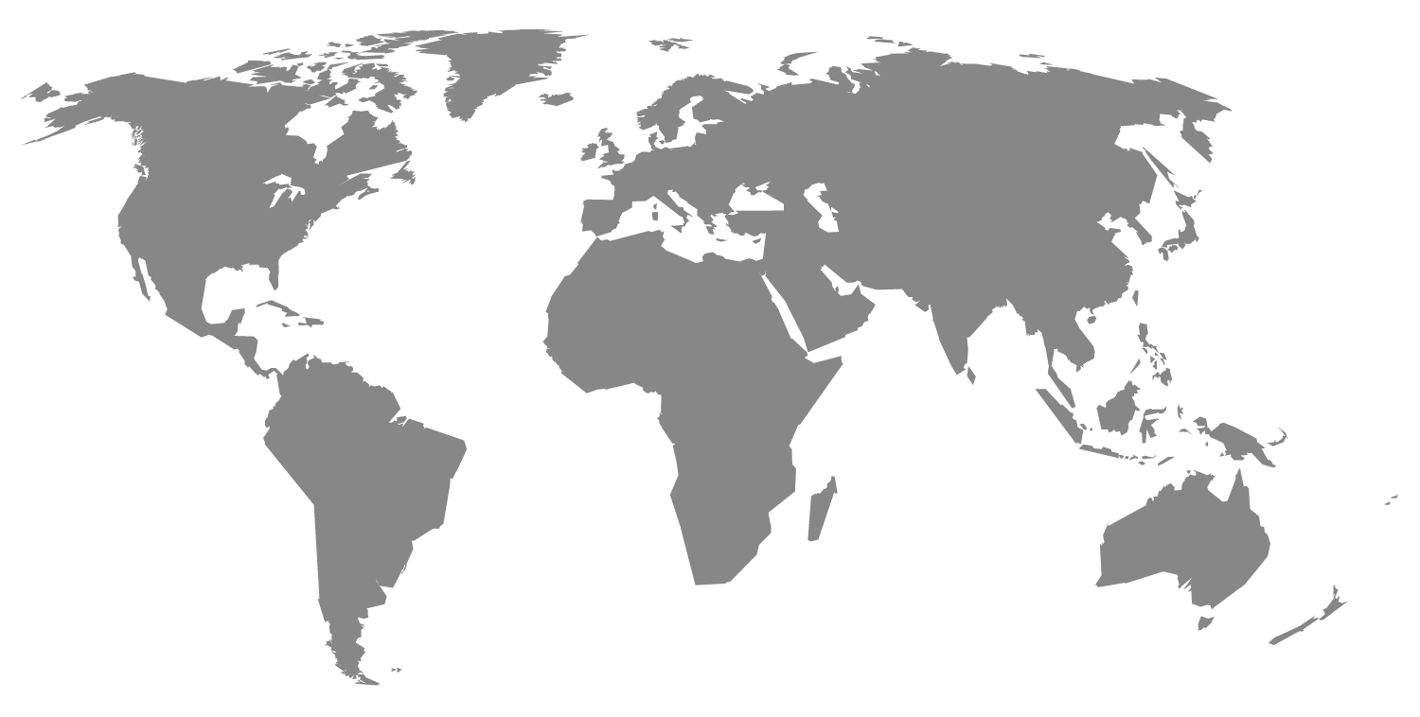
Maps
our office

Slide 44
89,526,124
Whoa! That’s a big number, aren’t you proud?

Slide 45
89,526,124$
185,244 users
100%
That’s a lot of money
And a lot of users
Total success!

Slide 46
Our process is easy
first
second
last

Slide 47
Let’s review some concepts
Yellow
Is the color of gold, butter and ripe lemons. In the spectrum of visible light, yellow is found between green and orange.
Blue
Is the colour of the clear sky and the deep sea. It is located between violet and green on the optical spectrum.
Red
Is the color of blood, and because of this it has historically been associated with sacrifice, danger and courage.
Yellow
Is the color of gold, butter and ripe lemons. In the spectrum of visible light, yellow is found between green and orange.
Blue
Is the colour of the clear sky and the deep sea. It is located between violet and green on the optical spectrum.
Red
Is the color of blood, and because of this it has historically been associated with sacrifice, danger and courage.

Slide 48
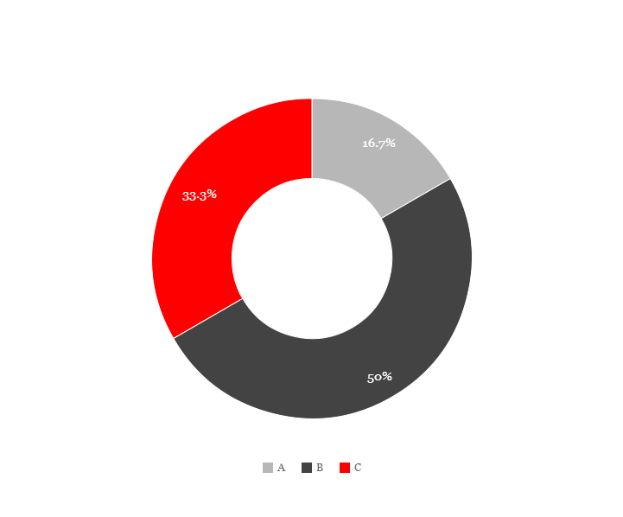
You can copy&paste graphs from Google Sheets

Slide 49
Android project
Place your screenshot here
Show and explain your web, app or software projects using these gadget templates.

Slide 50
iPhone project
Place your screenshot here
Show and explain your web, app or software projects using these gadget templates.

Slide 51
Tablet project
Place your screenshot here
Show and explain your web, app or software projects using these gadget templates.

Slide 52
Desktop project
Place your screenshot here
Show and explain your web, app or software projects using these gadget templates.

Slide 53
thanks!
Any questions?
You can find me at
@username
user@mail.me
?

Slide 54
Credits
Special thanks to all the people who made and released these awesome resources for free:
Presentation template by SlidesCarnival
Photographs by Unsplash

Slide 55
Presentation design
This presentations uses the following typographies and colors:
Titles: Roboto Slab
Body copy: Georgia (system font)
You can download the font on this page:
https://www.fontsquirrel.com/fonts/roboto-slab
Dark gray #111111
Light gray #999999
Red #ff0000
You don’t need to keep this slide in your presentation. It’s only here to serve you as a design guide if you need to create new slides or download the fonts to edit the presentation in PowerPoint®

Slide 56
SlidesCarnival icons are editable shapes.
This means that you can:
Resize them without losing quality.
Change line color, width and style.
Isn’t that nice? :)
Examples:

Slide 57
😉
Now you can use any emoji as an icon!
And of course it resizes without losing quality and you can change the color.
How? Follow Google instructions https://twitter.com/googledocs/status/730087240156643328
✋👆👉👍👤👦👧👨👩👪💃🏃💑❤😂😉😋😒😭👶😸🐟🍒🍔💣📌📖🔨🎃🎈🎨🏈🏰🌏🔌🔑 and many more...

